Slide 1
Gender Identification Project
Name:
Id:

Slide 2
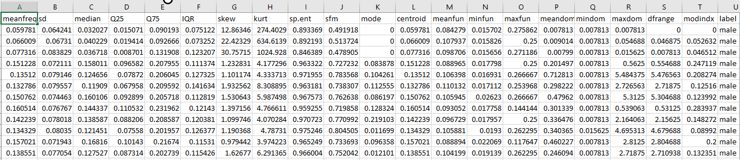
Dataset
I have used the Dataset of Human Pitches to identify weather its male or female

Slide 3
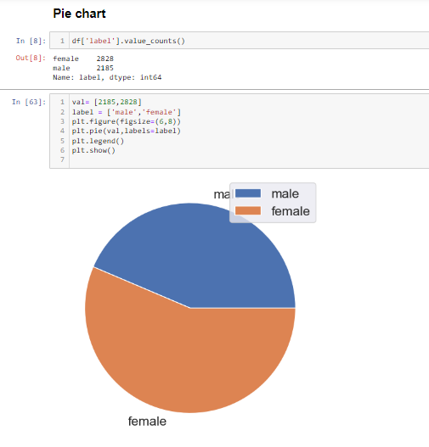
Preprocessing Steps
First I have checked for the missing values, after checking there were no missing values so that then I counted the male and female strength and plotted a Pie Chart

Slide 4
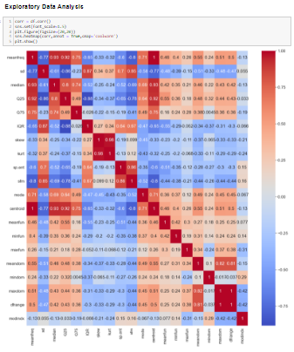
Exploratory Data Analysis
Correlation between all the features

Slide 5
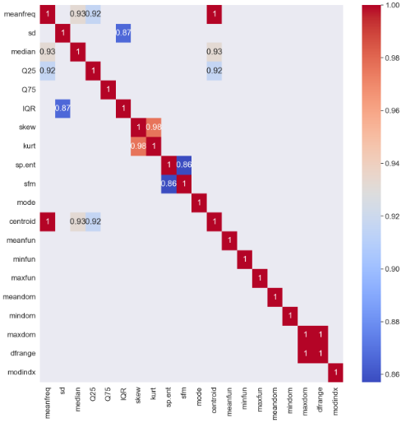
Exploratory Data Analysis
We will do EDA on similar columns with correlation higher than 0.8 and remove the columns which will not fetch us important patterns

Slide 6
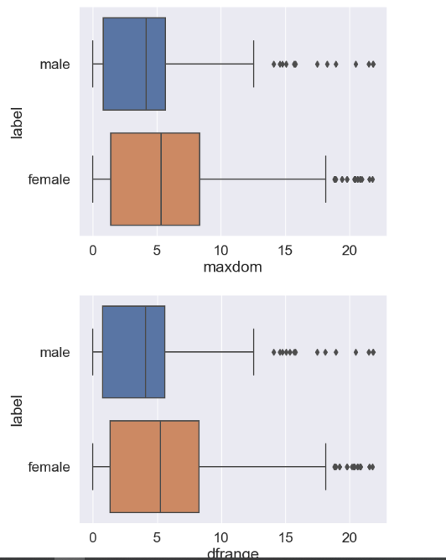
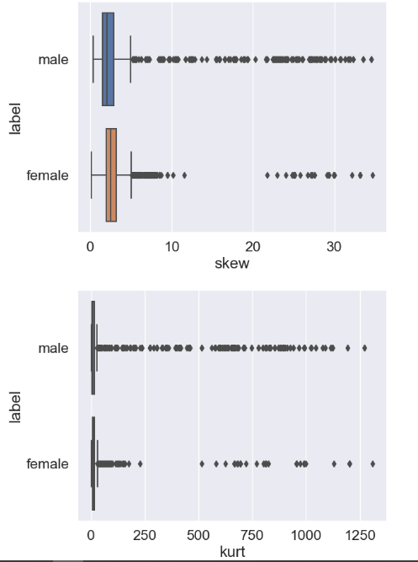
Exploratory Data Analysis
Removing Outliers

Slide 7
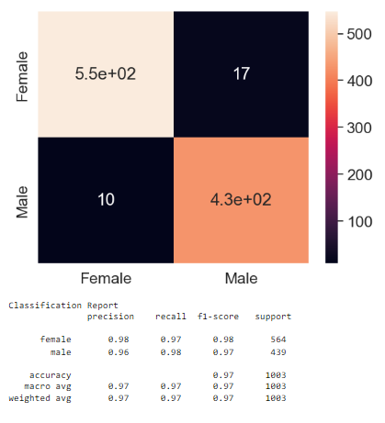
Model Training & Result
Decision Tree Classifier

Slide 8
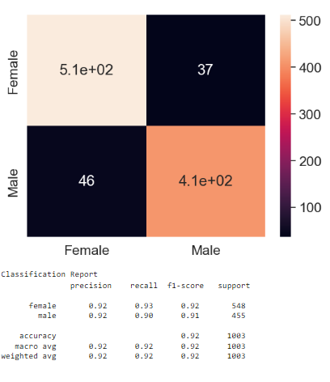
Model Training $ Result
Logistic Regression

Slide 9
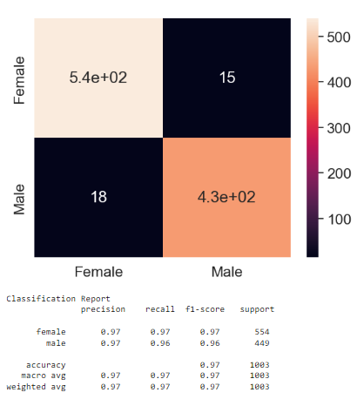
Model Training & Result
Support Vector Machine

Slide 10
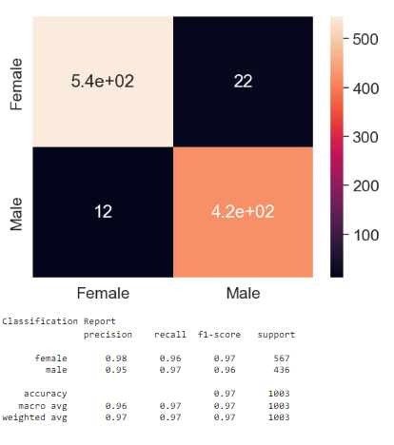
Model Training & Result
K Nearest Neighbor

